Slide 1
15. Vladimir Monomakh
Grand Prince of Kiev

Slide 2
Contents
Intro
The Siecle Ad
Etymology
Family Tree (Unrevealed | Revealed)
List of repeated names
Maps (1 | 2 | 3)

Slide 3
Intro
Hello and welcome to Tsar Power, I’m Roberto
And I’m Brendan, and together we rank all the Russian Rulers from Rurik to Putin. This week, Ruler number 15: Vladimir Monomakh.

Slide 4
The Siecle Ad
http://thesiecle.com/
https://www.facebook.com/thesiecle/
https://twitter.com/thesiecle

Slide 5
Etymology
Vladimir - Ruler of the World
Monomakh - He who fights alone

Slide 6
Go to list of names
Monomakh Family Tree (Sans Daughters)

Slide 7
Go to list of names
Monomakh Family Tree (Sans Daughters)

Slide 8
List of Repeated Names and who they are
Go to Family Tree
Go to Family Tree (Revealed)
Sviatoslav II - Grand Prince of Kiev/Episode 12
Oleg of Chernigov - Prince of Chernigov (at times)/ Episode 14.5
Vasilko and Volodar Rostislavich - Prince of Trebovil and Peremyshl. Vasilko was blinded
Yaropolk Iziaslavich - Son of Iziaslav I/Episode 10
Sviatopolk II - Grand Prince of Kiev/Episode 14
Itlar and Kytan - Cuman Chieftain/Retainer
David Sviatoslavich - Prince of Smolensk, then Co-Ruler of Chernigov
David Igorevich - Prince of Vladimir-Volynsky. Blinded Vasilko
Gleb Vseslavich - Prince of Polotsk. Son of Vseslav the Sorcerer/Episode 11
Yaroslav Sviatopolchich - Prince of Volhynia, Son of Sviatopolk II

Slide 9
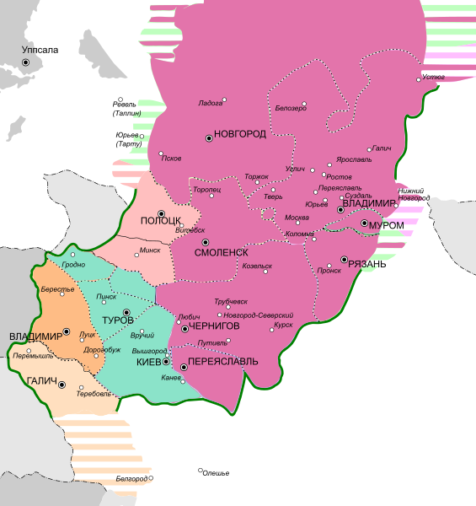
Kievan Rus in 1093 at the start of Sviatopolk II’s Reign
Purple - Monomakh
Pink - Vseslav the Sorcerer
Green - Sviatopolk II
Orange - David Igorevich
Yellow - Volodar and Vasilko

Slide 10
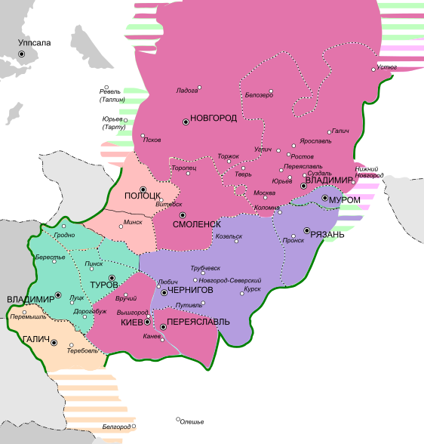
Kievan Rus in 1113 at the start of Monomakh’s Reign
Purple - Oleg of Chernigov
Magenta - Monomakh
Pink - Gleb Vseslavich
Green - Yaroslav Sviatopolchich
Yellow - Volodar and Vasilko

Slide 11
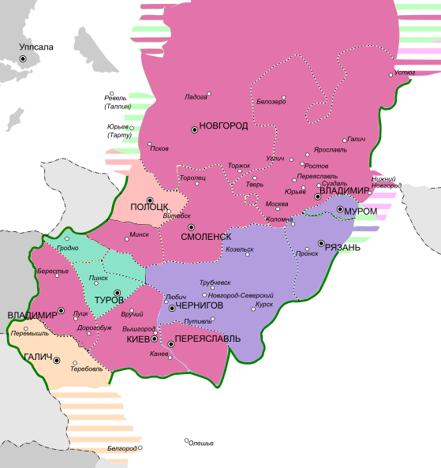
Kievan Rus in 1125 at the end of Monomakh’s Reign
Purple - Yaroslav Sviatoslavich (Sviatoslav II)
Magenta - Monomakh
Pink - Viacheslav Vladimirovich
Green - Andrei Vladimirovich
Yellow - Volodymyr Volodarevich

